Slide 1
Scleroderma is characterized by immune system activation, endothelial dysfunction, and enhanced fibroblast activity.
The earliest stage in the development of the scleroderma lesion is endothelial cell activation and vascular damage, the precise inciting events of which are unknown. This is followed by the extravasation of inflammatory cells, which initially are of the monocytic lineage. Later, there is a lymphocyte-predominant infiltrate. Eventually, a population of fibroblasts is activated. The autonomous activated fibroblasts continue to produce the excessive extracellular matrix that underlies the ultimate fibrotic pathology of scleroderma. Within the advanced lesional skin, there is very little visible evidence of ongoing inflammation, suggesting that this is a self-perpetuating fibrotic process.

Slide 2
The endothelium contributes to the regulation of the contraction and relaxation of vascular smooth muscle cells through the production and release of endothelium-derived vasoactive substances including prostacyclin (prostaglandin [PG]I₂), endothelium-derived relaxing factor (EDRF or nitric oxide), and endothelin. The impairment of endothelium-dependent vascular smooth muscle relaxation has been confirmed by the evidence of reduced serum levels of nitric oxide and prostacyclin in scleroderma. This state is probably worsened by increased endothelin levels that contribute to vasospasm and smooth muscle hypertrophy.

Slide 3
Endothelin-1 plays an important role in the pathogenesis of scleroderma. Elevated plasma endothelin is seen in scleroderma-associated pulmonary hypertension. During an episode of Raynaud's phenomenon, endothelin release is augmented. Increased endothelin-1 is also found in the bronchoalveolar lavage fluid from scleroderma patients and in prescleroderma skin and early diffuse skin lesions. Scleroderma lung fibroblasts shows elevated endothelin-1 expression and increases in endothelin-1 binding sites.

Slide 4
There are many other potent mediators of tissue fibrosis that are believed to play an important role in the pathogenesis of scleroderma. One of the key factors that has received the most attention as a very potent profibrotic factor, indirectly implicated very strongly in the pathogenesis of systemic sclerosis, is transforming growth factor (TGF)-β1. A number of studies have shown that TGF-β1 is a potent profibrotic factor in vitro and that TGF-β1 ligand expression is upregulated in the skin and the lungs of scleroderma patients. In very early lesional skin, immunostaining shows TGF-β1 ligand expression. There is also disruption of TGF-β1 receptor expression leading to modulation of TGF-β activity.

Slide 5
But the disorder isn’t confined to skin changes. It can affect your:
blood vessels
muscles
heart
digestive system
lungs
kidneys

Slide 6
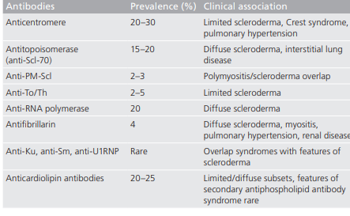

Slide 8
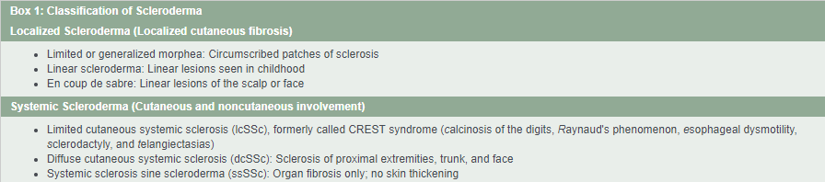

Slide 9
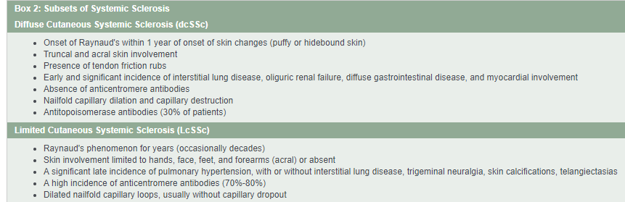

Slide 11
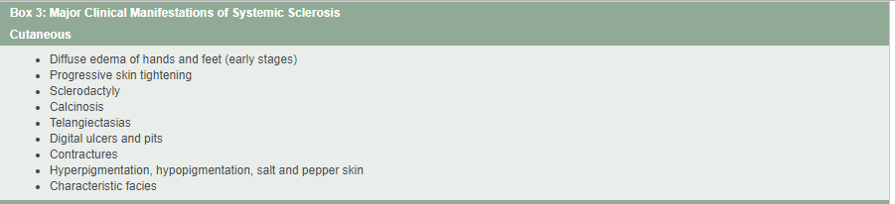

Slide 12
Склеродактилия. Обратите внимание на уплотнение кожи на пальцах и фиксированные контракции сгибания в проксимальных межфаланговых суставах у пациента с ограниченным системным склерозом

Slide 13
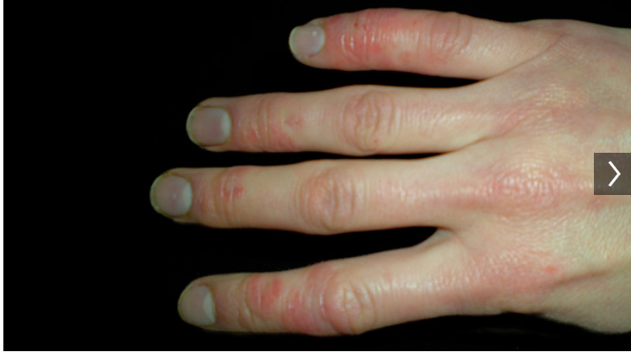

Slide 14
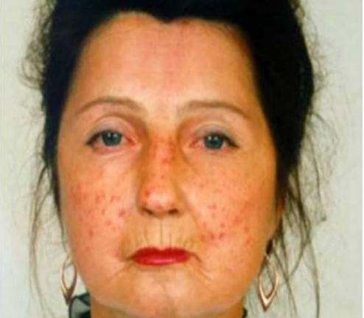

Slide 15


Slide 17
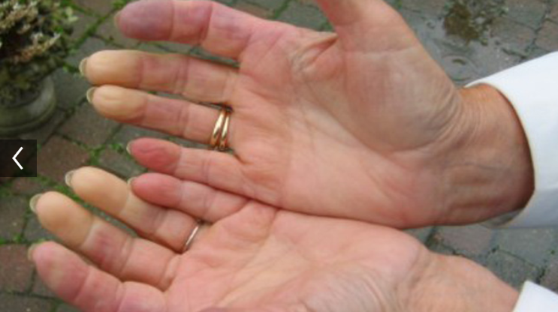

Slide 19
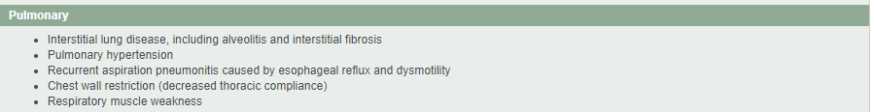

Slide 21
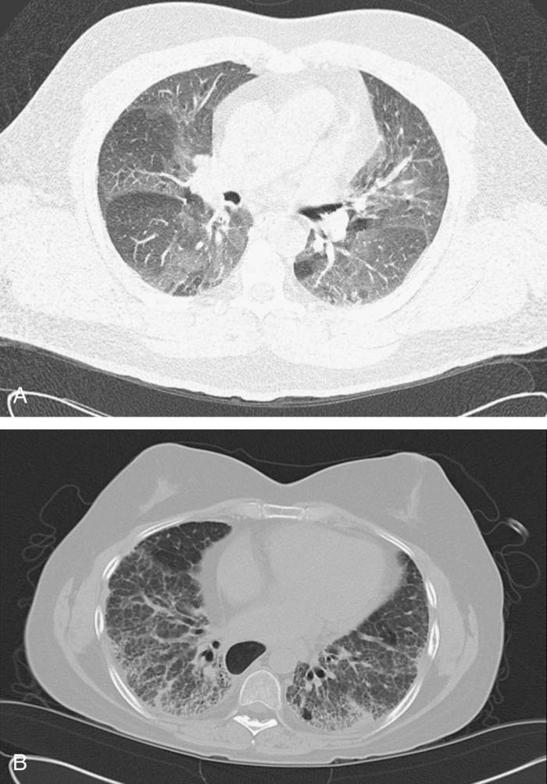
High-resolution computed tomography scan of the chest.A, Ground-glass opacification. B, Coarse reticulation and honeycombing.

Slide 22
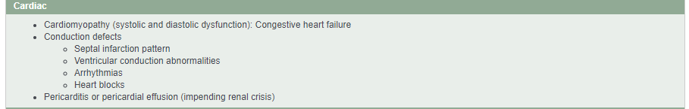

Slide 23
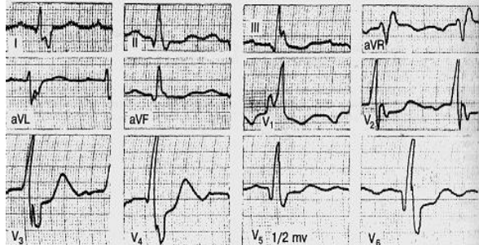

Slide 25
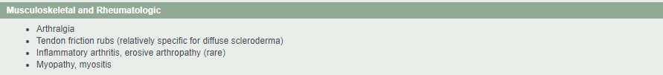

Slide 26
Обратите внимание на растворение терминальных фаланг у пациента с давно ограниченным кожным системным склерозом (lcSSc) и феномен Рейно.

Slide 28
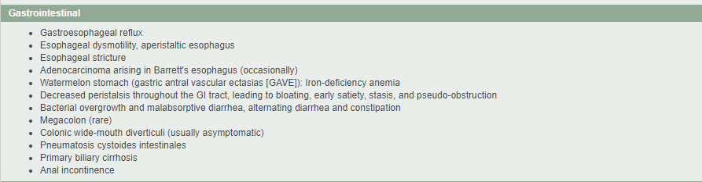

Slide 29
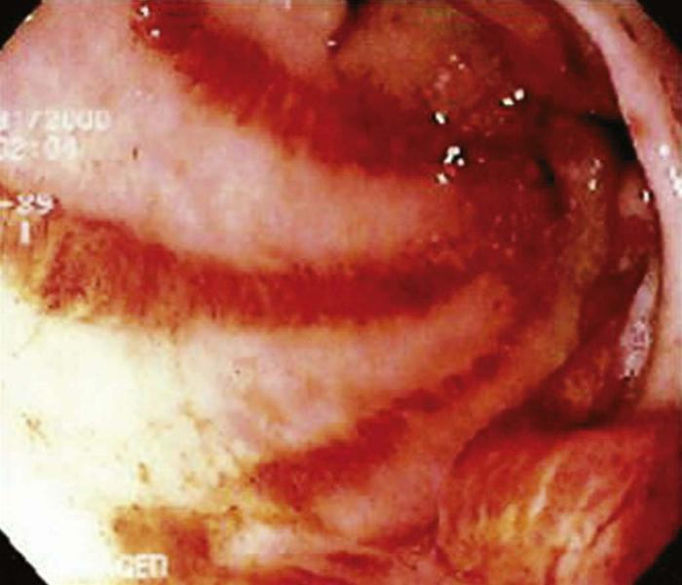
Gastric antral vascular ectasias (GAVE or watermelon stomach) can lead to chronic upper gastrointestinal bleeding and iron-deficiency anemia

Slide 30
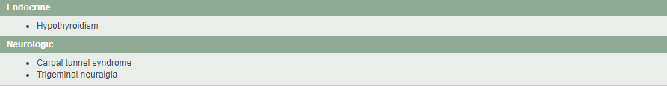

Slide 31
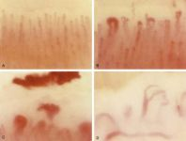
Nailfold capillaroscopy

Slide 32
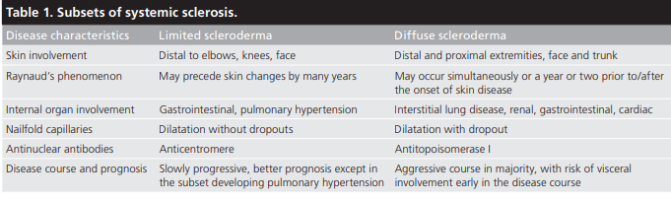

Slide 34
Criteria for the Classification of Systemic Sclerosis (Scleroderma)
1980 Criteria for the Classification of Systemic Sclerosis
The American College of Rheumatology (former American Rheumatism Association - ARA) has defined criteria, that are 97 % sensitive and 98 % specific for systemic sclerosis (SSc) as follows:
Major criterion:
Proximal diffuse (truncal) sclerosis (skin tightness, thickening, non-pitting induration)
Minor criteria:
Sclerodactyly (only fingers and/or toes)
Digital pitting scars or loss of substance of the digital finger pads (pulp loss)
Bilateral basilar pulmonary fibrosis
The patient should fulfill the major criterion or two of the three minor criteria. Raynaud's phenomenon is observed in 90-98 % of SSc patients.

Slide 35
ABCDCREST Criteria for the Classification of Systemic Sclerosis
1. Autoantibodies: autoantibodies to centromere proteins (CENPs) detected by indirect immunofluorescence; anti-Scl-70 (topoisomerase I) detected by double immunodiffusion; anti-fibrillarin (U3-RNP) detected by immunoprecipitation
2. Bibasilar pulmonary fibrosis detected by chest radiograph: linear shadows or “honey-comb” reticular appearance most expressed at the periphery of the lungs and at the bases
3. Contracture of the joints defined as permanent limitation of joint motion. The prayer sign is detected when a patient opposed the palmar surfaces of both hands with extended wrists. The sign is positive when the patient is unable to oppose the palms. This suggests joint or skin pathology, or shortening of the forearm flexors

Slide 36
4. Dermal thickening can be defined by the modified Rodnan skin score, which employs clinical palpation of the skin as described
5. Calcinosis cutis, most often located on the fingers, is intra and/or subcutaneous deposits of hydroxyapatite that can ulcerate the skin; it can be detected by radiography, crystallographic or chemical analysis
6. Raynaud’s phenomenon is a sudden pallor of an acral structure (e.g., fingers, whole hand, toes, tip of nose, earlobe, or tongue). The involved area may subsequently develop cyanosis and, with re-warming, become erythematous. Determination is by patient’s history or physician’s observation

Slide 37
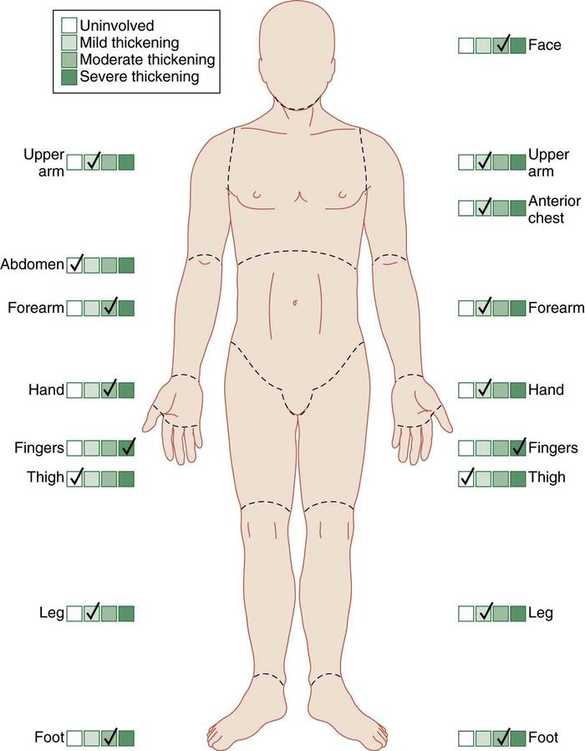

Slide 38
7. Esophageal distal hypomotility can be detected by cine/video barium esophagram, performed in the upright and supine position. Reflux-esophagitis can be detected by esophagogastroduodenoscopy in the forms of erosive esophagitis or Barret’s esophagus
8. Sclerodactyly is symmetric thickening and tightening of the skin on the digits. Before sclerodactyly develops there could be a phase of non-pitting digital edema of varying duration. It is defined as non-pitting increase in soft tissue mass of the digits that extends beyond the normal confines of the joint capsules
9. Teleangiectasias are visible macular dilatations of superficial cutaneous blood vessels that collapse upon pressure and fill slowly when pressure is released. Common locations are the digits, face, lips, tongue
A classification of definite SSc requires three or more criteria.

Slide 39
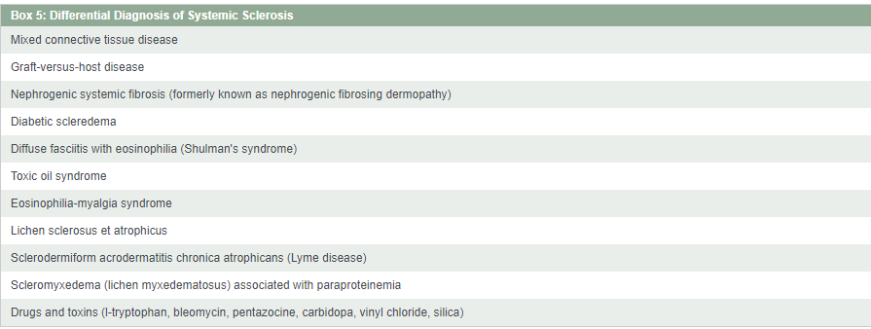

Slide 40
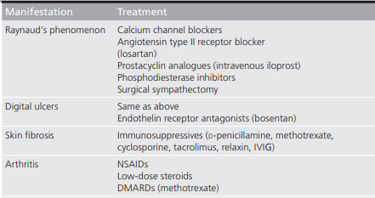

Slide 41
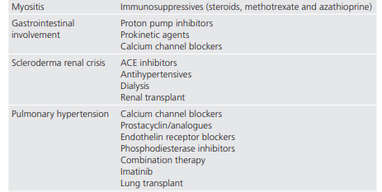

Slide 42
